Slide 1
What can we do as Individuals, a Department, and a Field to increase Diversity, Equity, and Inclusion?
2020-09-22
-Please feel welcome to turn your video “off” or “on”
Notes:
I want to thank Daisy Hernandez in the Rizzo lab and the rest of the organizing committee for the invitation to start a department discussion about diversity, equity, and inclusion. Before we get started, I would like to invite everyone to turn their video feed off or on, depending on their preference. While I speak today, Dave will be sorting us into Zoom breakout rooms for a brainstorming discussion. In the Zoom chat, Guy Robinson is sharing a link to a Google document that outlines several actions that we can take to improve diversity, equity and inclusion. Your group can choose to annotate that document. Go ahead and open the link in case the Zoom chat changes once we are in breakout sessions. The title of this talk is “What can we do as individuals, a department, and a field to increase diversity, equity, and inclusion?” This is framed as a question because this talk will not have all the answers. Furthermore, key questions help us organize our knowledge and our approach and motivate us to push the field onward and upwards.

Slide 2
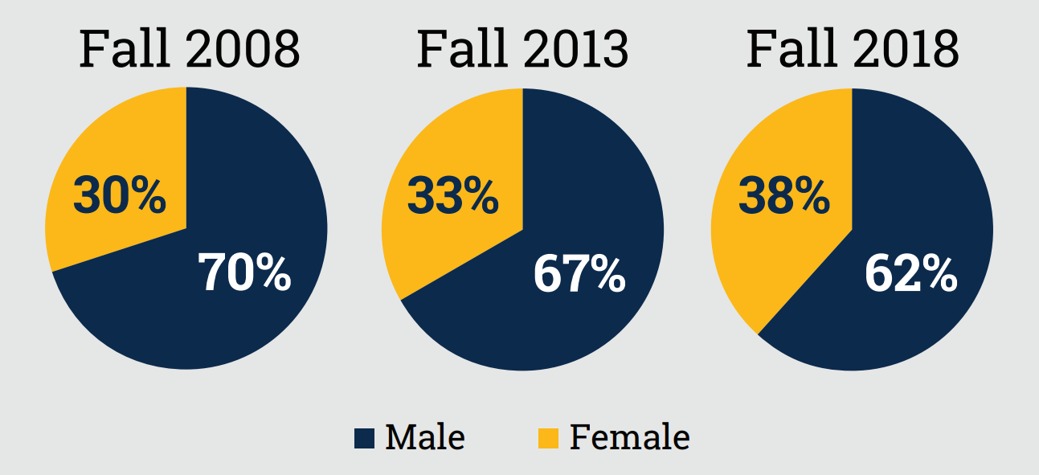
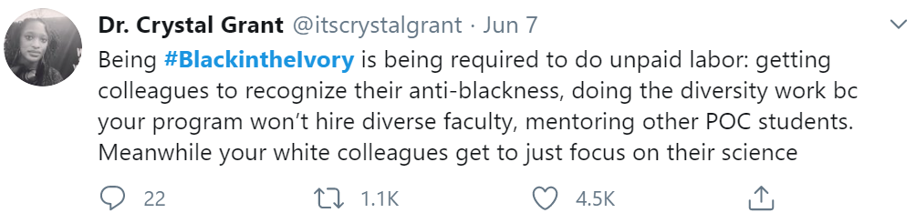
My Background
B.S. Georgia Tech 2006-2010
Ph.D. UW Madison 2010-2017
Women’s Recruitment Activities
Focused on science & mentoring
Notes:
What is my background? I earned my Bachelor’s in Biology at Georgia Tech, which is a public university that specializes in engineering and STEM. It’s also a university that is known for having a male-dominated student population. Although women make up over half of the undergrad population across the country, women accounted for less than a third of the Georgia Tech student population when I was a student. I was a student volunteer for institutional women’s recruitment activities that have had a significant but slow effect to improve gender diversity on campus.
After my B.S. I earned my PhD at UW Madison and focused mainly on bacteriology and developing my mentoring skills.
Reading through social media this summer, this Tweet from Dr. Crystal Grant struck a chord. She said: “Being #BlackingtheIvory is being required to do unpaid labor: getting colleagues to recognize their anti-blackness, doing the diversity work because your program won’t hire diverse faculty, mentoring other POC students. Meanwhile your white colleagues get to just focus on their science.” As a white professor, I believe it is important to both try to share the effort and to recognize and value the extra efforts that Black, Indigenous and other Scientist of Color support.

Slide 3
I am not an expert
Notes:
I am not an expert on diversity, equity, and inclusion. Additionally, I would like to acknowledge that it is a privilege to learn about racism second hand rather than experiencing it directly.

Slide 4
Why Value Diversity?
-Diversity enhances excellence, creativity, and innovation
-Diversity ensures fairness in our highly diverse nation
-Lack of diversity represents a loss of talent
Adapted from NIH Scientific Workforce Diversity Toolkit and Scientific American
Notes:
Why value diversity

Slide 5
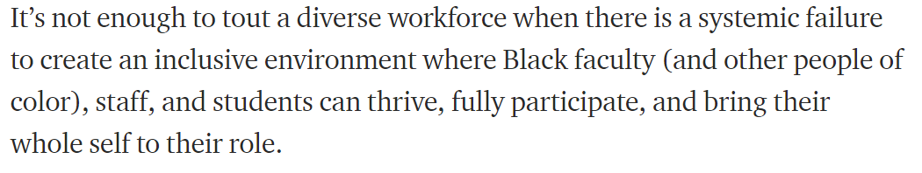
-Dr. Jasmine Roberts, Ohio State University
Notes:
I would like to start with this quote from Dr. Jasmin Roberts at the Ohio State University. ….

Slide 6
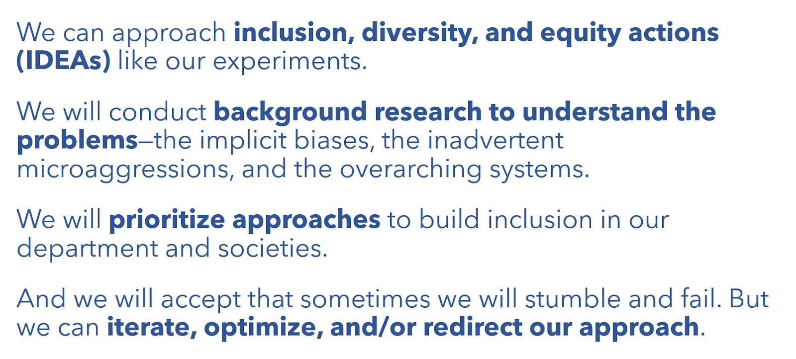
What can we do?
Notes:
Nevertheless, what can we do to increase diversity, inclusion, and equity? We’re scientists, so I think we will be effective if we approach inclusion, diversity, and equity actions like our experiments.

Slide 7
What can we do?
Notes:
We can conduct background research to understand the problems – the implicit biases, the microaggressions, and the overarching systems.

Slide 8
What can we do?

Slide 9
What can we do?

Slide 10
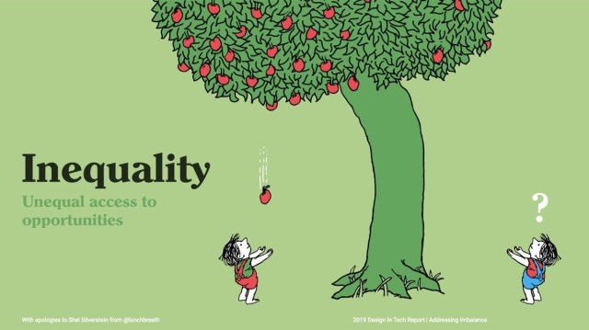
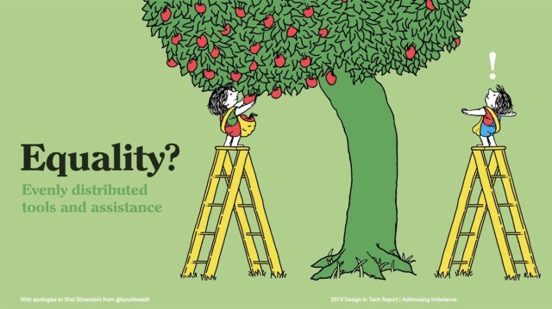
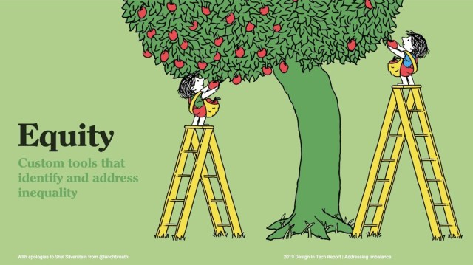
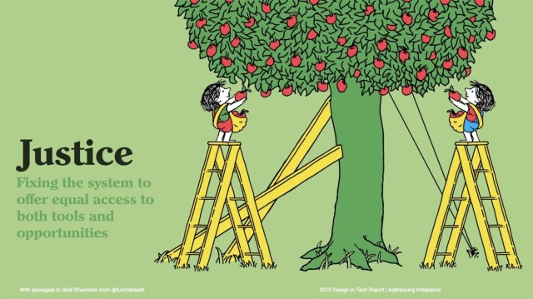
What can we do? Example: Undergraduate research opportunities
Rely on undergraduates to contact labs
Research
requirement for all students
-Paid research
-Peer networks
Tony Ruth Design in Tech Report | Addressing Imbalance

Slide 11

Mentoring Networks
Tony Ruth Design in Tech Report | Addressing Imbalance

Slide 12

Break Out Rooms – What can we do to build Diversity, inclusivity, and equity?
Discussions are optional
Please be respectful

Slide 13
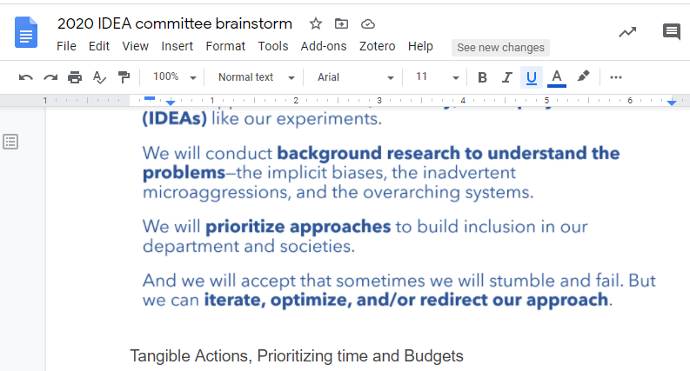
Break Out Rooms –
Option A
Option B:
https://docs.google.com/document/d/1pIzyDyUZPD2-_F1BeE9dQCgZWDlujwQRxHvSVAunzlA/edit?usp=sharing
Make your own Google Doc to collaboratively take notes. Share with Dave Rizzo/Tiffany Lowe-Power if you want to
Anyone can “comment”

